Slide 1
DevOps tech The technical practices of flow
Notes:
Author: Ahmed Hosni
1

Slide 2
Agenda
Part 1:
Version control
Continuous integration
Deployment automation
Trunk-based development
Test automation and Test data management
Workshops
Part 2:
Automating / accelerating database (state-based and migration-based approaches)
Architecture
Docker and Kubernetes: The Big Picture
Workshops
2

Slide 3
DevOps in Context
3

Slide 4
SOURCE CODE MANAGEMENT (SCM)
Notes:
Author: Ahmed Hosni
4

Slide 5
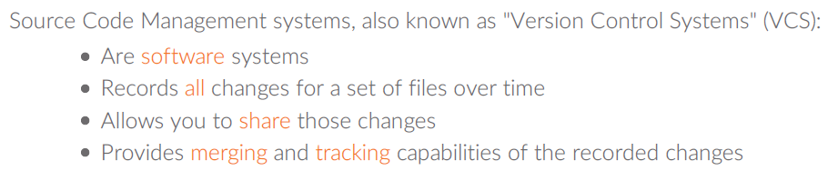
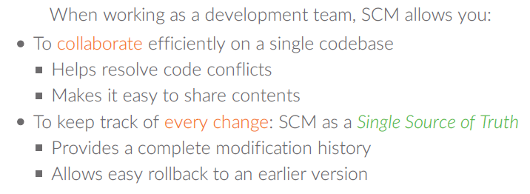
What is SCM?

Slide 6
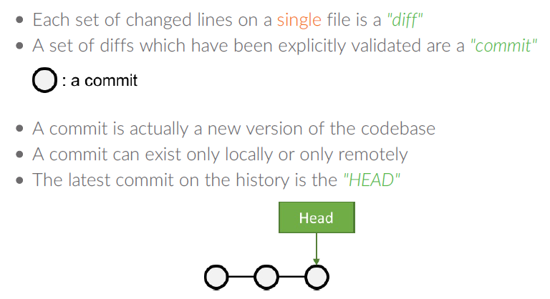
Scm terminology: basics

Slide 7
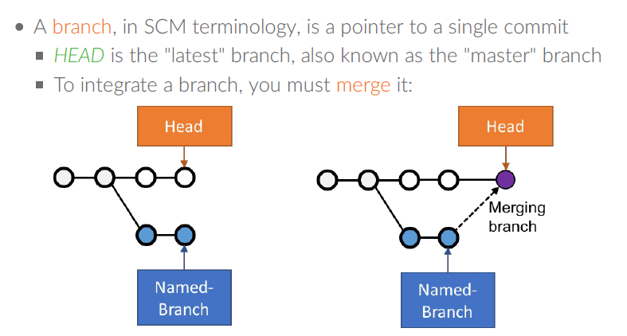
Scm terminology: basics

Slide 8
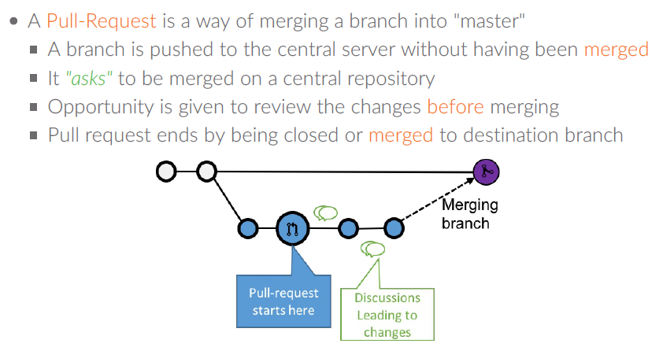
Scm terminology: pull request

Slide 9
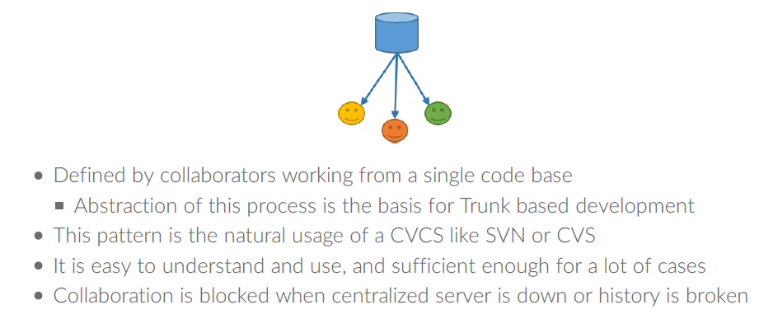
Centralized Workflow Pattern

Slide 10
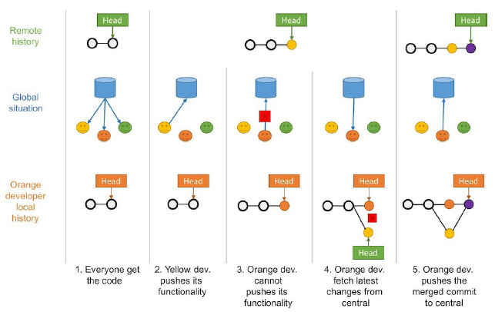
Centralized Workflow Pattern
How to?

Slide 11
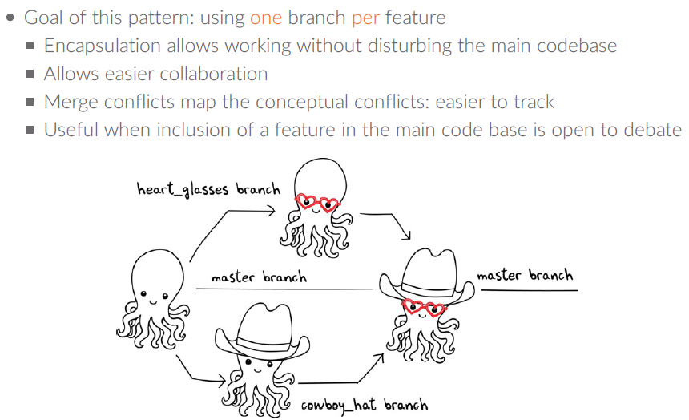
Feature Branch Workflow Pattern

Slide 12
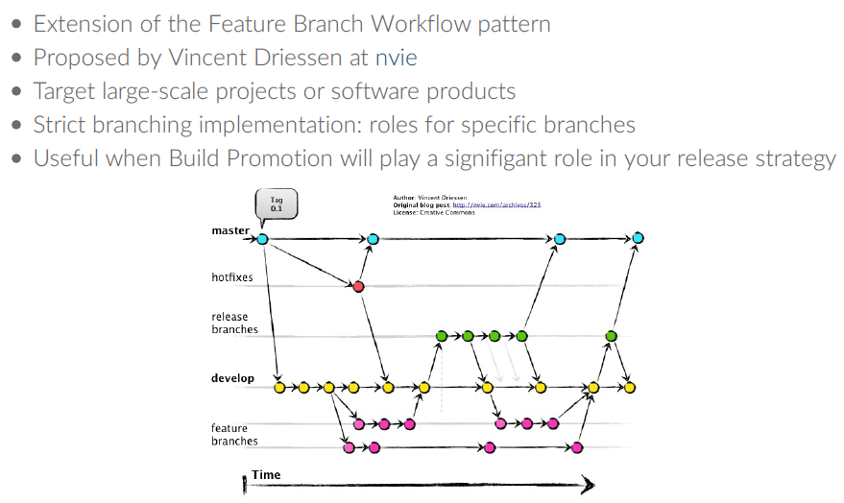
Git Workflow Pattern
Notes:
https://nvie.com/

Slide 13
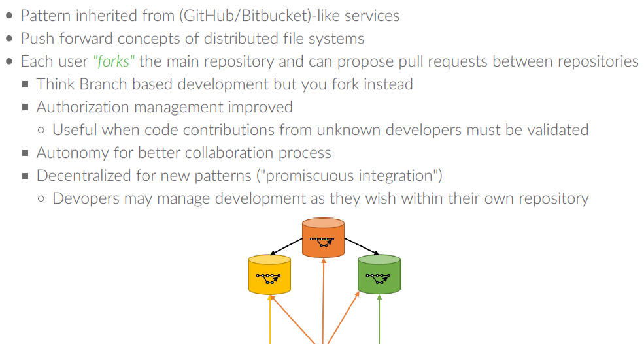
Fork Workflow Pattern
Notes:
https://nvie.com/

Slide 14
All application code and dependencies (for example, libraries and static content)
Any script used to create database schemas, application reference data, and so on.
All environment creation tools and artifacts described in the previous step (for example, VMware or AMI image building scripts or Chef recipes)
Any file used to create and compose containers (for example, Docker files and buildpacks)
All supporting automated tests and any manual test scripts
How to implement version control Team must check in the following assets to their shared version control repository:

Slide 15
How to implement version control Team must check in the following assets to their shared version control repository:
Any script that supports code packaging, deployment, database migration, and environment provisioning
Supporting project artifacts (for example, requirements documentation, deployment procedures, and release notes)
Container orchestration (for example, Kubernetes configuration, Mesos configuration, and Docker Swarm configuration)
All cloud configuration files (for example, AWS Cloudformation templates, Microsoft Azure Stack DSC files, OpenStack HEAT, Terraform files, etc…)
Any other script or configuration information required to create infrastructure that supports multiple services (for example, enterprise service buses, database management systems, DNS zone files, configuration rules for firewalls, and other networking devices)

Slide 16


Notes:
https://nvie.com/

Slide 17
Trunk-based development

Slide 18
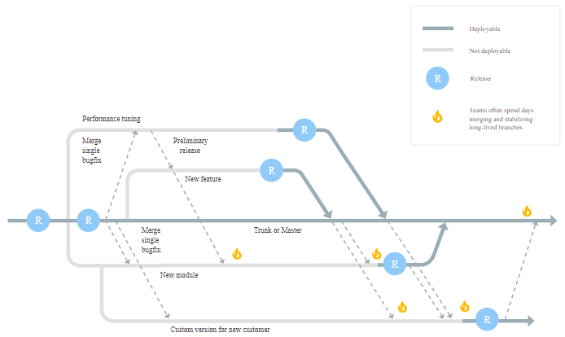
Typical non-trunk-based development style
Notes:
There are two main patterns for developer teams to work together using version control.
One is to use feature branches, where either a developer or a group of developers create a branch usually from trunk (also known as master or mainline) and then work in isolation on that branch until the feature they are building is complete.
When the team considers the feature ready to go, they merge the feature branch back to trunk.

Slide 19
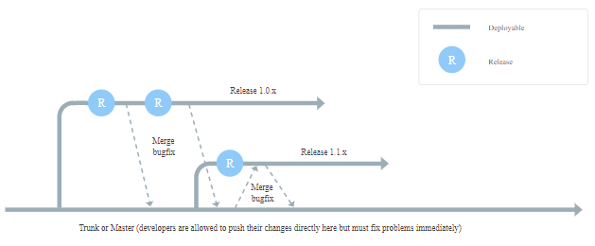
Typical trunk-based development timeline
Notes:
The second pattern is known as trunk-based development, where each developer divides their own work into small batches and merges that work into trunk at least once (and potentially several times) a day.
The key difference between these approaches is scope.
Feature branches typically involve multiple developers and take days or even weeks of work. In contrast, branches in trunk-based development typically last no more than a few hours, with many developers merging their individual changes into trunk frequently.

Slide 20
Common pitfalls
An overly heavy code-review process:
Many organizations have a heavyweight code review process that requires multiple approvals before changes can be merged into trunk.
When code review takes hours or days, developers avoid working in small batches and instead batch up many changes.
This in turn leads to a downward spiral where reviewers procrastinate with large code reviews due to their complexity.
Performing code reviews asynchronously:
If your team practices pair programming, then the code has already been reviewed by a second person.
If further reviews are required, they should be performed synchronously:
When the developer is ready to commit the code, they should ask somebody else on the team to review the code right then.
Not running automated tests before committing code:
In order to ensure trunk is kept in a working state, it's essential that tests are run against code changes before commit.
This can be done on developer workstations, and many tools also provide a facility to run tests remotely against local changes and then commit automatically when they pass.

Slide 21
Ways to improve trunk-based development
Develop in small batches
Perform synchronous code review
Implement comprehensive automated testing
Have a fast build.
Create a core group of advocates and mentors

Slide 22
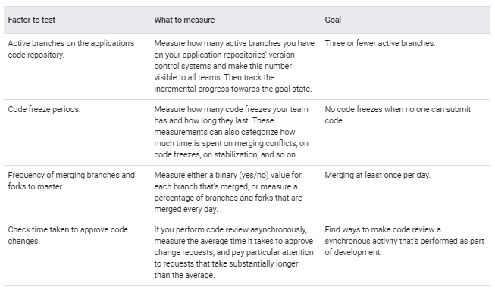
Ways to measure trunk-based development

Slide 23
Continuous Integration

Slide 24
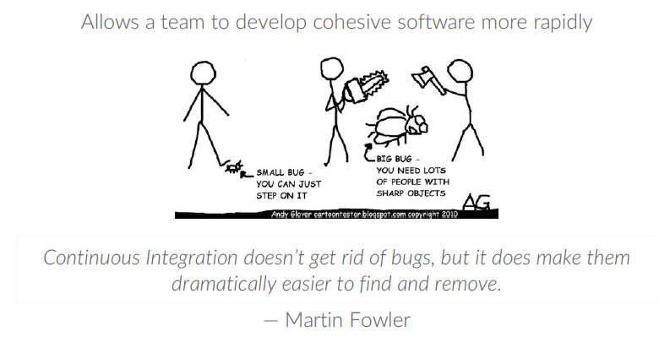
Why Use Continuous Integration ?
Notes:
https://nvie.com/

Slide 25
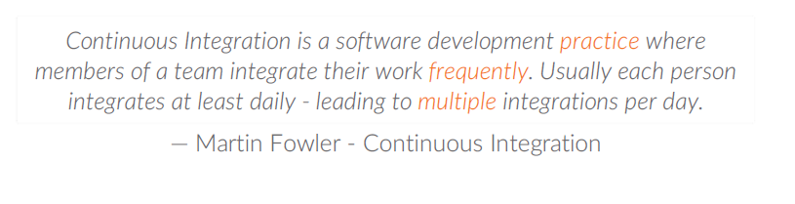
What is Continuous Integration (Ci) ?
Notes:
https://nvie.com/

Slide 26
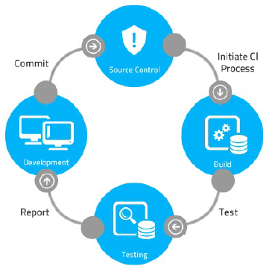
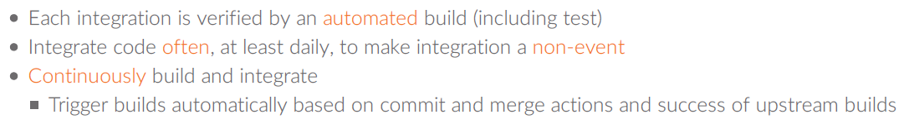
How to Do Continuous Integration ?
Notes:
https://nvie.com/

Slide 27
Common pitfalls
Not putting everything into the code repository:
Everything that's needed to build and configure the application and the system should be in your repository.
Not automating the build process:
Manual steps create opportunities for mistakes and leave steps undocumented.
Not fixing broken builds right away:
A key goal of CI is having a stable build from which everyone can develop.
If the build can't be fixed in a few minutes, the offending change should be identified and reverted.
Not triggering quick tests on every change:
Full end-to-end tests are necessary, but quick tests (unit tests) are also important to enable fast feedback.
Not merging into trunk often enough:
Many organizations have automated tests and builds, but don't enforce a daily merge into trunk.
This leads to long-lived branches that are harder to integrate, and to long feedback loops for the developers.

Slide 28
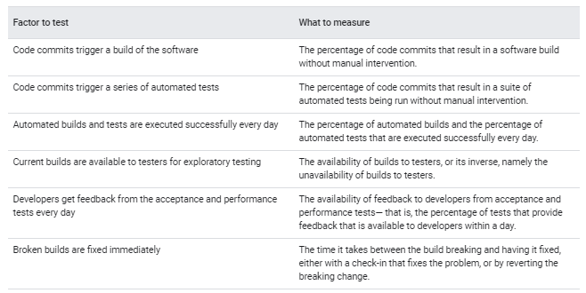
Ways to measure CI

Slide 29
Continuous Delivery

Slide 30
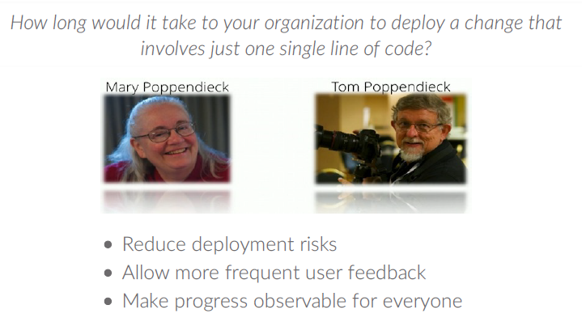
Continuous Delivery (Cd)

Slide 31
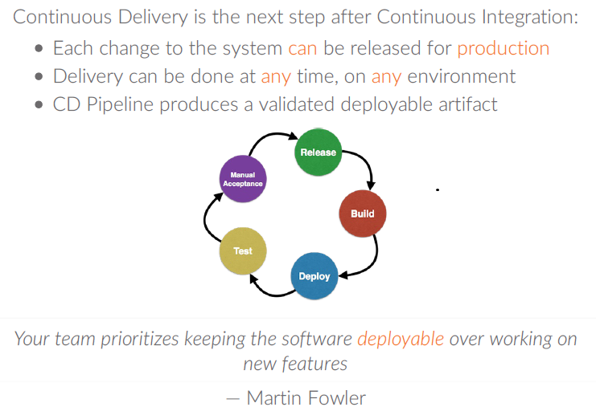
Why Use Continuous Delivery?

Slide 32
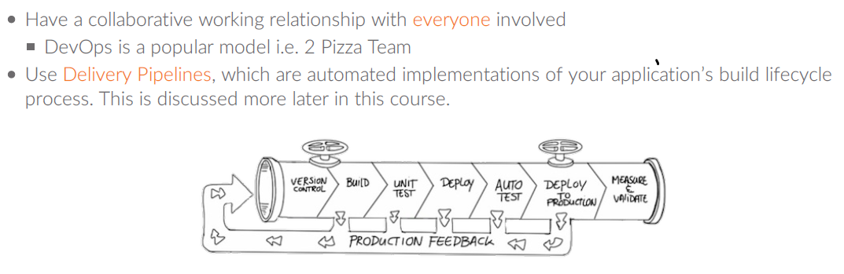
How to Do Continuous Delivery?

Slide 33
Continuous Deployment

Slide 34
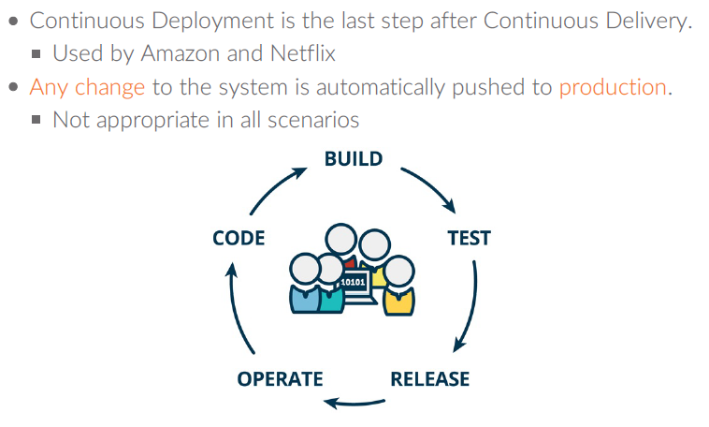
What is Continuous Deployment ?

Slide 35
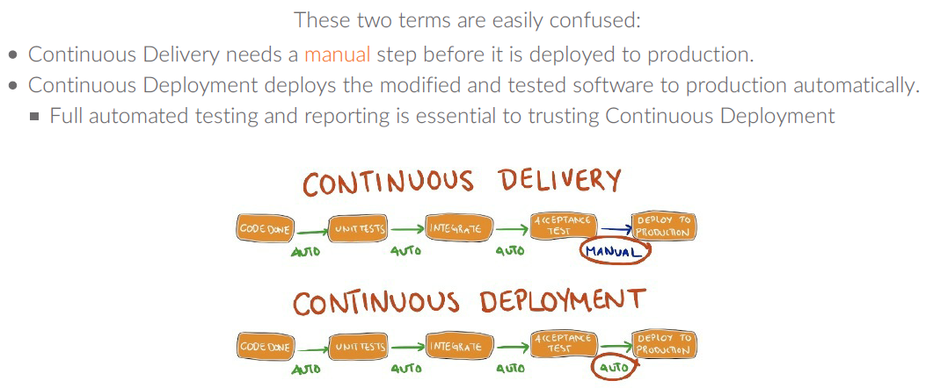
Continuous Delivery Versus Deployment

Slide 36
CI/CD Pipelines

Slide 37
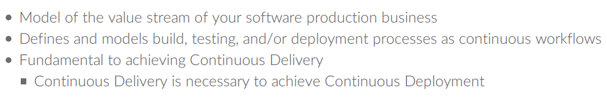
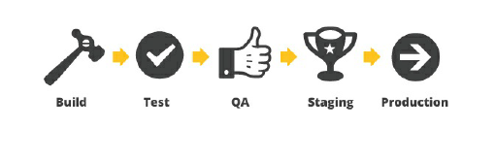
WHAT IS A CI/CD PIPELINE?

Slide 38
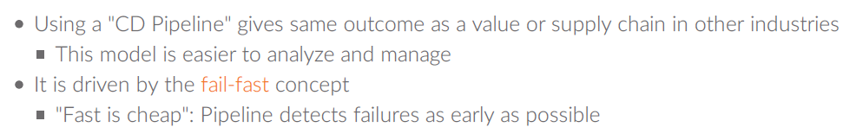
WHY USE A CI/CD PIPELINE?

Slide 39
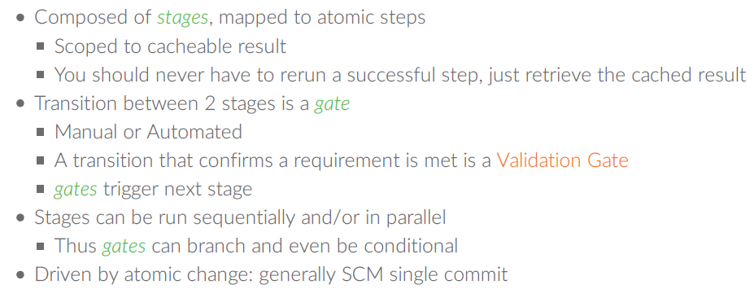
Anatomy of CI/CD Pipelines

Slide 40
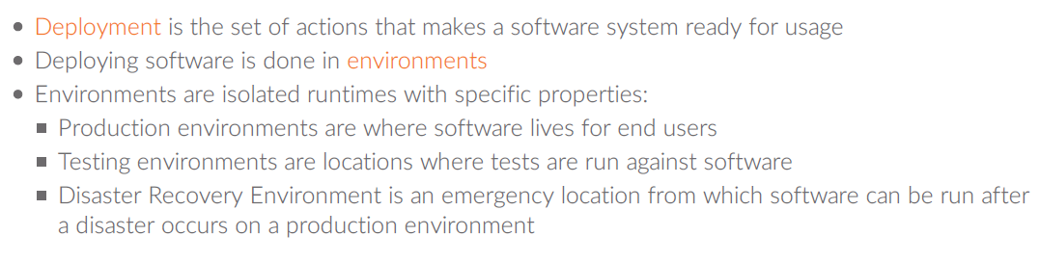
Deployment Stages of a CD Pipeline

Slide 41
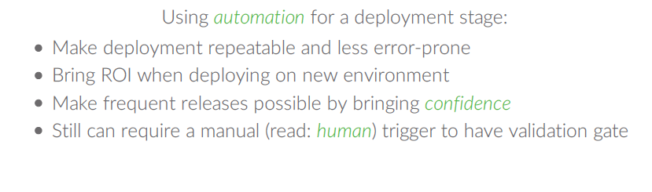
Automated Deployment

Slide 42
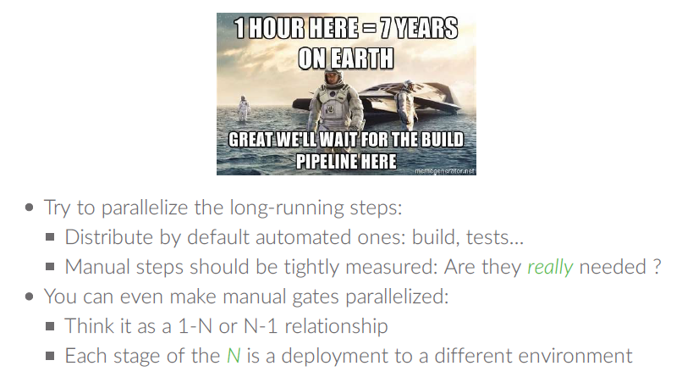
Keep Pipelines Efficient

Slide 43
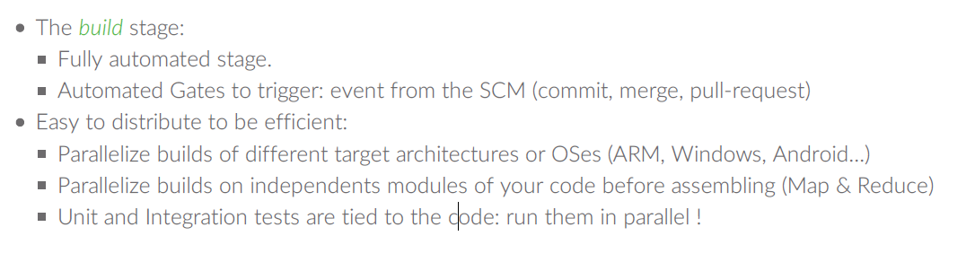
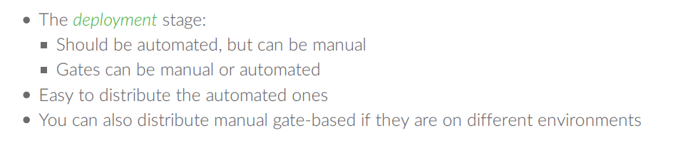
Distributing Stages

Slide 44
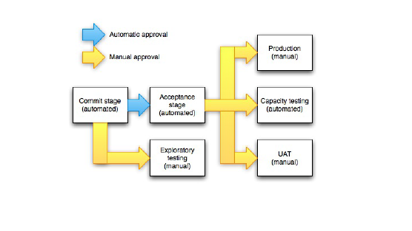
An Optimized Pipeline Example

Slide 45
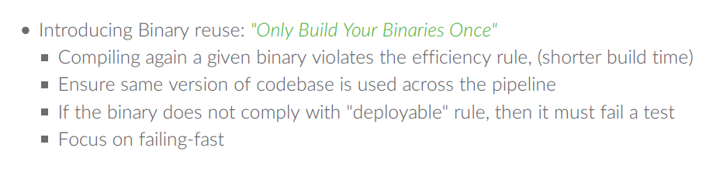
Always Build Upon Good Foundations

Slide 46
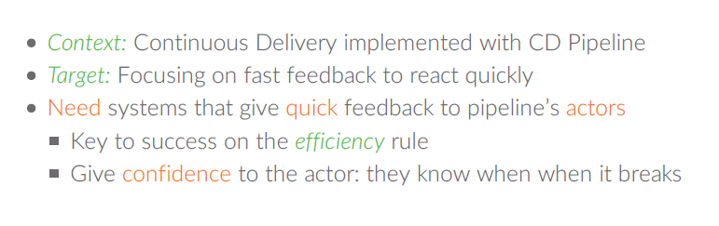
Why Have a Feedback Loop?

Slide 47
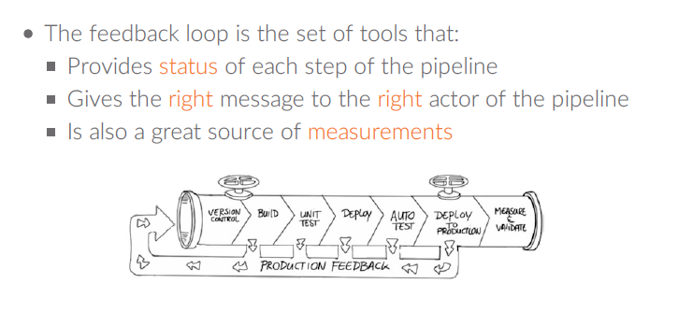
What is a Feedback Loop?

Slide 48
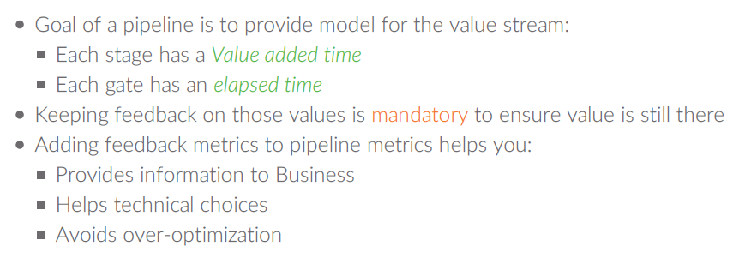
Measuring the Pipeline: Kpis and Metrics
Notes:
Measuring deployment automation is straightforward:
Count the number of manual steps in your deployment process. Work to systematically reduce those steps. The number of manual steps increases the deployment time as well as the opportunity for error.
Measure the level (or percentage) of automation in your deployment pipeline. Work to continually increase that level.
Determine the time spent on delays in the deployment pipeline. As you work to reduce these delays, understand where and why code stalls in your deployment pipeline.

Slide 49
Ways to improve deployment automation
Packaging code in ways suitable for deployment.
Creating pre-configured virtual machine images or containers.
Automating the deployment and configuration of middleware.
Copying packages or files into the production environment.
Restarting servers, applications, or services.
Generating configuration files from templates.
Running automated deployment tests to make sure the system is working and correctly configured.
Scripting and automating database migrations.

Slide 50
Test automation and Test data management

Slide 51
The need for test automation
Manual regression testing is time-consuming to execute and expensive to perform, which makes it a bottleneck in the process.
Software can't be released frequently and developers can't get quick feedback.
Manual tests and inspections are not reliable:
- People are poor at repetitive tasks like manual regression tests.
- It is hard to predict the impact of changes on a complex software system through inspection.
For systems that evolve over time, keeping test documentation up to date requires a considerable effort.
Notes:
https://nvie.com/

Slide 52
How to implement test automation?
1- Unit tests:
These typically test a single method, class, or function in isolation, providing assurance to developers that their code operates as designed.
To ensure that the code is testable and tests are maintainable, write tests before the code, a technique also known as test-driven development (TDD).
Notes:
https://nvie.com/

Slide 53
How to implement test automation?
2- Acceptance tests:
These typically test the app as a whole to provide assurance that a higher level of functionality operates as designed and that regression errors have not been introduced.
Example acceptance tests might check for the business acceptance criteria for a user story, the correctness of an API, and broken functionality that was previously operating correctly.
Write these tests as part of the development process.
No one should be able to declare their work "dev complete" unless automated acceptance tests are passing.
Notes:
https://nvie.com/

Slide 54
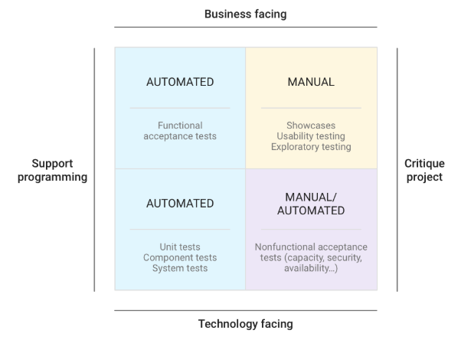
How to implement test automation?

Slide 55
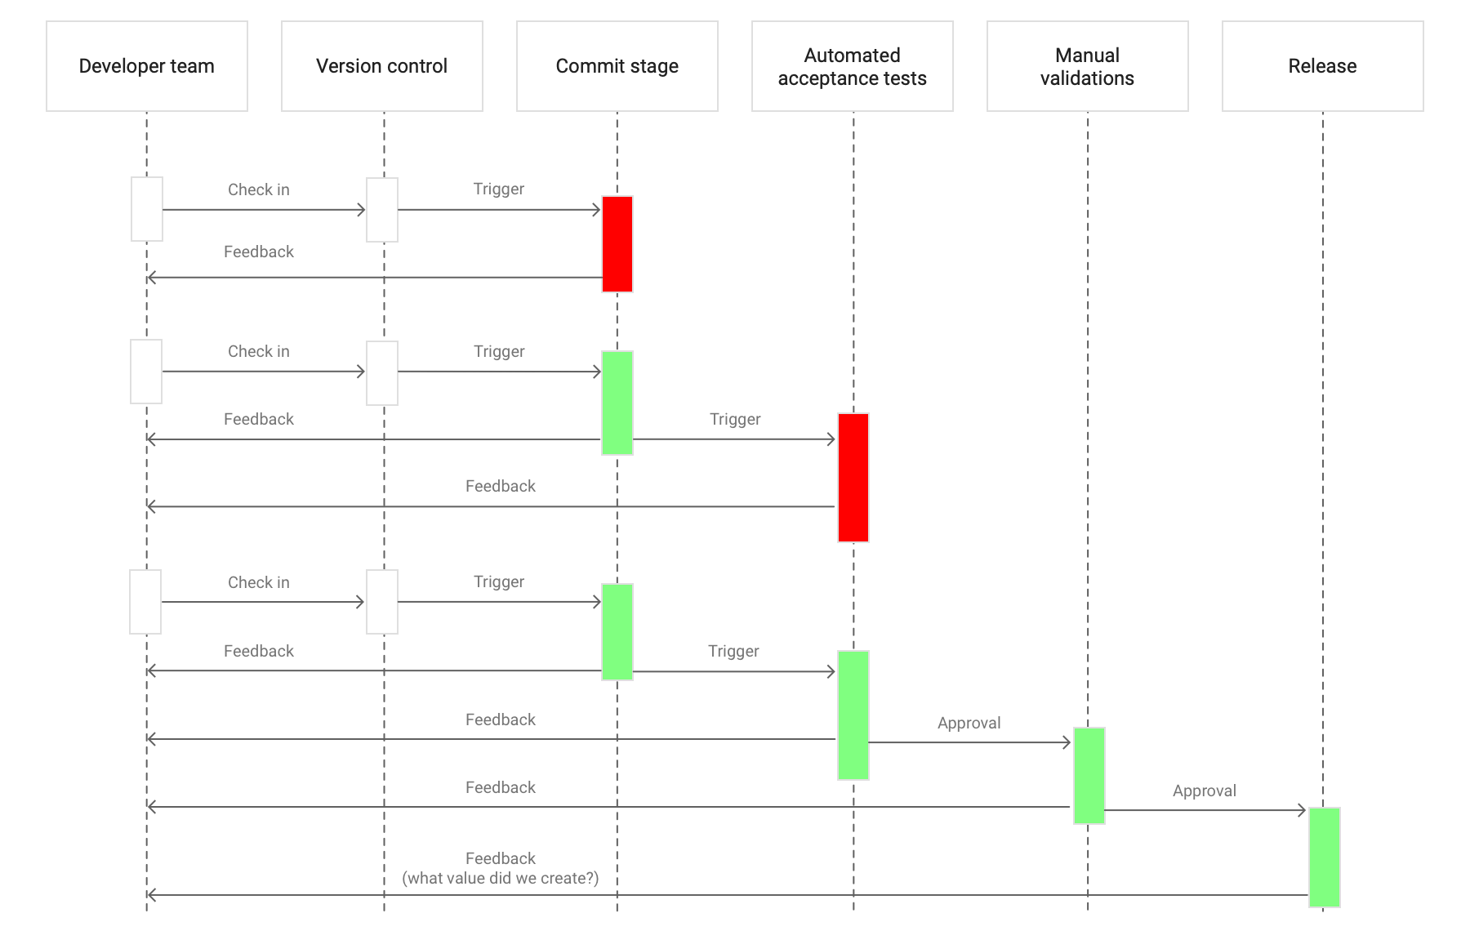
How to implement test automation?
Notes:
Red represents negative feedback, either tests or checks that have failed. Green represents positive feedback, meaning all checks have passed.
In the deployment pipeline pattern, every change creates a release candidate and the quick feedback loop helps to catch problems as early in the process as possible.
When a package reaches the end of the pipeline and the team still doesn't feel comfortable with releasing it, or if they discover defects in production, the pipeline must be improved, perhaps by adding or updating tests.

Slide 56
Common pitfalls in test automation
Not having developers involved in testing
Test suites are frequently in a broken state:
- Code changes might require tests to be updated.
- If developers are not responsible for test automation, the build pipeline stays broken until the responsible team fixes the tests.
Developers often generate code that is hard to test:
- Developers tend to solve the problem they are given without thinking about how it will be tested.
- This can lead to either poorly designed test suites or to the test automation team refactoring a lot of code.
Notes:
This doesn't mean that you should get rid of testers or QA teams.
Testers have a unique perspective on the system because they understand how users interact with it.
It's a best practice to pair testers with developers to help testers create and evolve the suites of automated tests.
This way, developers learn the testers' perspective, and testers can learn about automation.
Testers should also perform exploratory testing as part of the deployment pipeline.

Slide 57
Common pitfalls in test automation
Having the wrong proportion of unit and acceptance tests.
A specific design goal of an automated test suite is to find errors as early as possible.
This is why faster-running unit tests run before slower-running acceptance tests, and both are run before any manual testing.
You should find errors with the fastest test category as possible.
When you find an error in an acceptance test or during exploratory testing, add a unit test to make sure this error is caught faster, earlier, and cheaper next time.

Slide 58
Common pitfalls in test automation
Failing to curate your test suites
If every time you change your code you must also change multiple unit tests, you're probably over-relying on mocking, or failing to prune your unit test suite.
Acceptance test suites should typically represent real end-to-end user journeys through the system, rather than being collections of automated acceptance criteria.
Keep your test suites well-factored:
If every change to your UI causes multiple acceptance tests to fail, use the page object pattern to decouple your tests from the system under test.
Notes:
https://martinfowler.com/bliki/PageObject.html

Slide 59
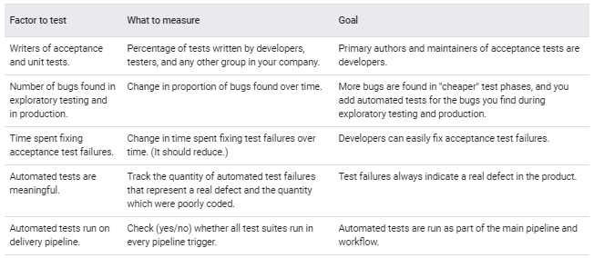
Measuring test automation
Notes:
https://nvie.com/

Slide 60
Common pitfalls in test data management
Over-reliance on data in testing:
Unit tests should not depend on data or state external to the test.
Using a full copy of the production database, rather than identifying relevant or important portions.
Not masking or hashing sensitive data.
Relying on data that is out of date or no longer relevant.
Notes:
https://nvie.com/

Slide 61
Improving test data management
Prefer unit tests
Unit tests should be independent of each other and any other part of the system except the code being tested.
Unit tests should not depend on external data.
Unit tests should make up the majority of your tests
Well-written unit tests that run against a well-designed codebase are much easier to triage and cheaper to maintain than higher-level tests.
Increasing the coverage of your unit tests can help minimize your reliance on higher-level tests that consume external data.

Slide 62
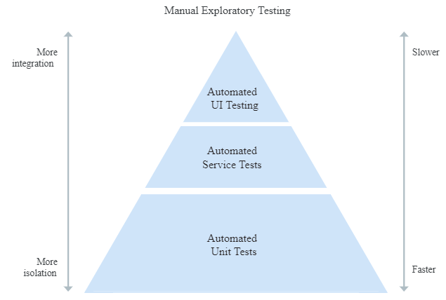
Improving test data management
Prefer unit tests
Notes:
https://martinfowler.com/articles/practical-test-pyramid.html#TheTestPyramid

Slide 63
Improving test data management
Minimize reliance on test data
Test data requires careful and ongoing maintenance.
As your APIs and interfaces evolve, you must update or re-create related test data.
This process represents a cost that can negatively impact team velocity.
It’s then a good practice to minimize the amount of test data needed to run automated tests.

Slide 64
Improving test data management
Isolate your test data
Run your tests in well-defined environments with controlled inputs and expected outputs that can be compared to actual outputs.
Make sure that data consumed by a particular test is explicitly associated with that test, and isn't modified by other tests or processes.
Your tests should create the necessary state themselves as part of setup, using the application's APIs.
Isolating your test data is also a prerequisite for tests to run in parallel.
Notes:
https://nvie.com/

Slide 65
Improving test data management
Minimize reliance on test data stored in databases
Maintaining test data stored in databases can be particularly challenging:
Poor test isolation:
- Databases store data durably;
- Any changes to the data will persist across tests unless explicitly reset.
- Less reliable test inputs make test isolation more difficult, and can prevent parallelization.
Performance impact:
- Speed of execution is a key requirement for automated tests.
- Interacting with a database is typically slower than interacting with locally stored data.
- Favor in-memory databases where appropriate.

Slide 66
Improving test data management
Make test data readily available
Running tests against a copy of a full production database introduces risk:
It can be challenging and slow to get the data refreshed. The data can become out of date.
Production data can also contain sensitive information.
Instead:
Identify relevant sections of data that the tests require.
Export these sections regularly and make them easily available to tests.

Slide 67
Measuring test data management
Adequate test data is available to run full automated test suites
You can measure this by:
Tracking how much time developers and testers spend managing and manipulating data for use in test suites.
You can also capture this by perceptual measures (like surveys) to ask teams if they have adequate data for their work, or if they feel this is a constraint for them.

Slide 68
Measuring test data management
Test data for automated test suites can be acquired on demand
You can measure this as:
The percentage of key data sets that are available
How often those data sets are accessed
How often they are refreshed.

Slide 69
Measuring test data management
Test data doesn't limit or constrain the automated tests that teams can run
You can measure this as:
The number of automated tests that can be run without the need to acquire additional test data.
You can also capture this with perceptual measures (like surveys), to ask teams if they feel that test data limits their automated testing activities.

Slide 70
Workshop Anatomy of an application
Notes:
https://hub.docker.com/r/fobbyal/maven-dind

Slide 71
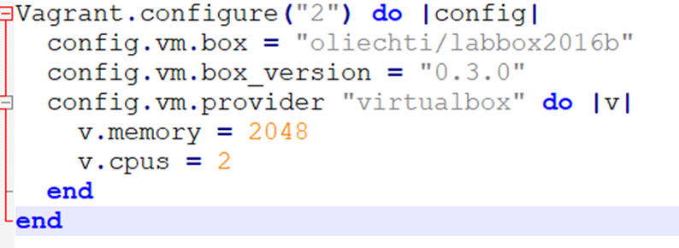
Provisioning the dev environment
The following software is pre-installed in the box:
java 7 and java 8 (build 1.8.0_72-b15)
maven 3.3.3
node.js 4.3.1
docker 1.10.1
docker images: mongo:3, node:4, httpd:2.4
Notes:
https://app.vagrantup.com/oliechti/boxes/labbox2016b/versions/0.3.0

Slide 72
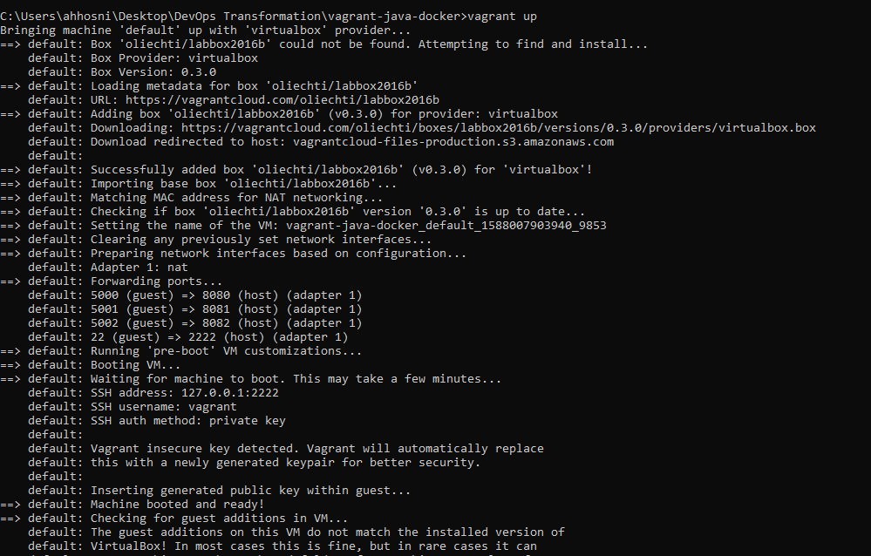
Provisioning the dev environment

Slide 73
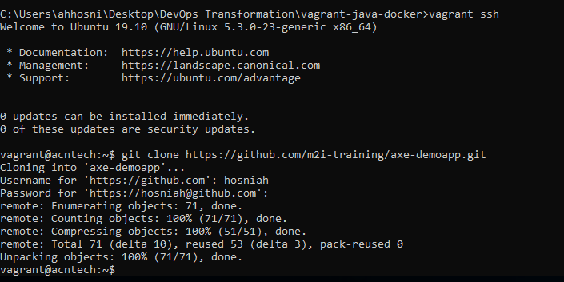
Fetch the demo app source code

Slide 74
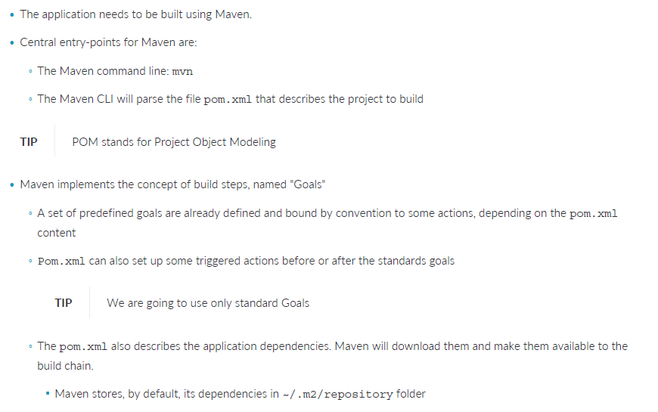
Building and Testing the Application

Slide 75
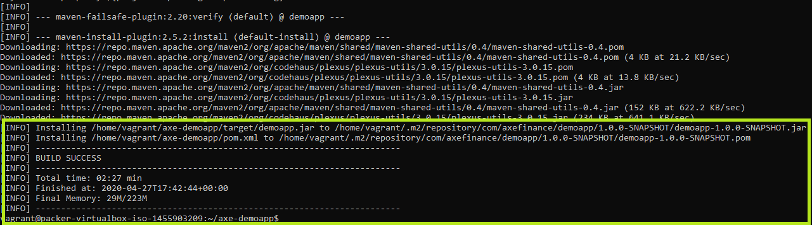
Building and Testing the Application
Cleaning the generated artifacts: mvn clean
Compiling the application:
mvn compile
Package the compiled classes:
mvn package
Run the Unit Tests:
mvn test
Run the Integration Tests:
mvn verify
Installing in the target folder:
mvn install

Slide 76
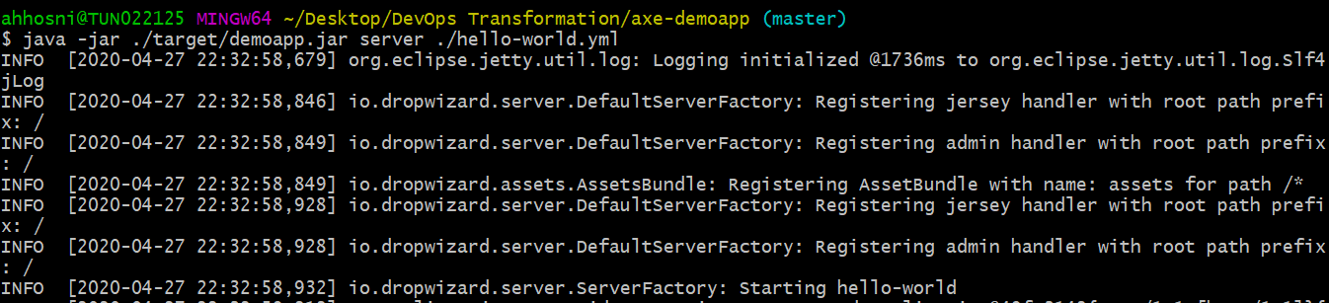
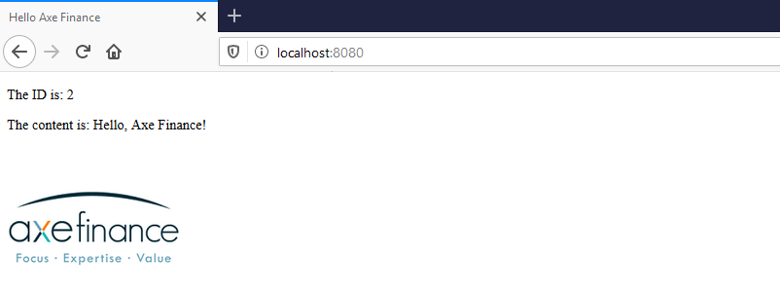
Running the dem-app
> java -jar ./target/demoapp.jar server ./hello-world.yml

Slide 77
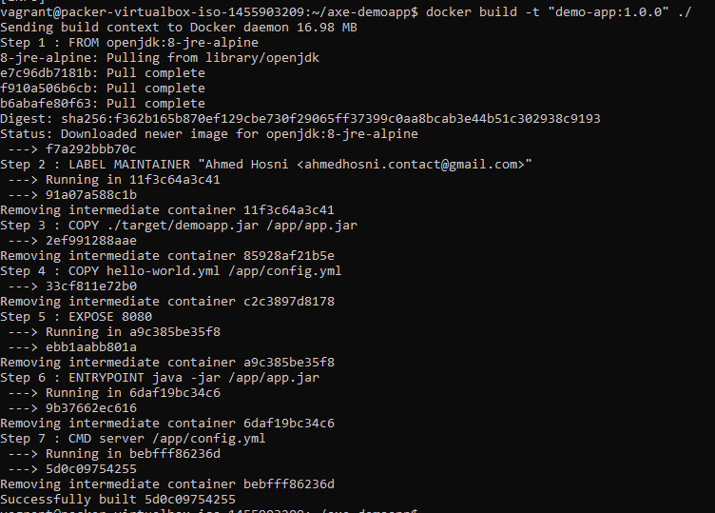
Running with Docker

Slide 78
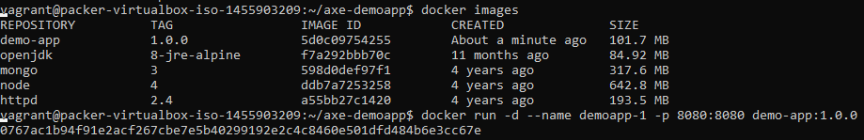

Building and Testing the Application

Slide 79


Building the demo app using Gitlab CI
https://gitlab.com/hosniah/axe-demoapp/pipelines
Notes:
https://gitlab.com/hosniah/axe-demoapp

Slide 80

Building the demo app using Gitlab CI

Slide 81


CI workflow using Github Actions

Slide 82

CD Workflow using Github Actions

Slide 83

CD Workflow using Github Actions

Slide 84

New release published to Dockerhub

Slide 85
Architecture
Notes:
Rethink team structures, purpose and interaction

Slide 86

Monoliths vs Microservices

Slide 87

Monoliths vs Microservices
Notes:
https://www.infoq.com/presentations/cloud-anti-patterns

Slide 88

Monoliths vs Microservices
Notes:
http://martinfowler.com/articles/dont-start-monolith.html

Slide 89

Monoliths vs Microservices
Notes:
http://www.codingthearchitecture.com/2014/07/06/distributed_big_balls_of_mud.html

Slide 90

Monoliths vs Microservices

Slide 91
Architectures for continuous delivery
When teams adopt continuous delivery practices, adopting the following architectural practices drives successful outcomes:
Teams can make large-scale changes to the design of their systems without the permission of somebody outside the team or depending on other teams.
Teams are able to complete work without needing fine-grained communication and coordination with people outside the team.
Teams deploy and release their product or service on demand, independently of the services it depends on or of other services that depend on it.
Teams do most of their testing on demand, without requiring an integrated test environment.
Teams can deploy during normal business hours with negligible downtime.

Slide 92

How to implement architectures for continuous delivery

Slide 93
Automating / accelerating database

Slide 94

CI/CD ORCHESTRATORS still Don’t Cover it
CircleCI
Jenkins
Harness.IO
TravisCI
Bamboo
GoCD
UrbanCode
ElectricCloud
CA Technologies
XebiaLabs
We can run a SQL script real good for ya!
Notes:
Some do have a plugins from 3rd party tools ), but generally…

Slide 95
The thing About Databases
Databases are sticky, stateful things
Despite having one of the oldest, most standardized DSLs, they are not managed ‘as code’
There is more than just data in databases
Structural changes can destroy data
Databases are buried in “Deep Ops”
Wrapped in layers of fear, security, process, legend, and ITIL dogma
One does not simply update a schema…

Slide 96
Organizational Stuff Database management in enterprises today
Still a “Black Box” on the other side of a wall you throw things over
ITIL regulated ‘shared service’ on the other side of ServiceNow tickets, email, Slack, etc.
“Full Stack” Developers who write SQL or rely on code generators
Vastly outnumbered DBAs
Fear-driven and toil-centric culture around databases
Database platform proliferation
Management running on about how data is now the company’s most valuable asset

Slide 97

Why so difficult?
The penalty for failure is large and only increasing
- There are VERY large databases out there - growing with no end in sight
- Needing to restore something from backup would be VERY time-consuming
Very manual processes for pushing changes through a pipeline
- Insurance policy of ‘expert’ doing the work
- Someone to own the blame
Environment drift control (side change injection)
- Difficulty limiting change vectors through the pipeline
- Really weak test environment and Test Data Management (TDM) practices
Limited SQL skills and knowledge
- Developers often have the basics, but do not handle the performance implications of changes
- DBAs make handy scapegoats
Organizations are trying to reduce RDBMS license spend

Slide 98

Automating Database change management Basic Approaches
Migration-based
“Change” is the first-class citizen
You develop change scripts
State-based
“State” is the first-class citizen
Uses DIFF approach to generate change scripts

Slide 99
Comparing
Migration-based
State-based
“As Code” approach
Requires knowledge of SQL & DB Engine
Change Creator specifies what will be changing
Only cares about impacted objects
“Point and Click” approach
Tool has the knowledge
Tool discovers the changes
Cares about ALL objects

Slide 100
Observations - Strengths
Migration-based
State-based
Easier to isolate and track trace change source
Easier to merge changes from many creators / teams
Easier to isolate changes in very large DBs
Easier to define or exclude groups of changes for ‘release’ promotions
Easier for data-intensive refactoring and scripting
Easier for closed teams
Easier for single app / single DB situations
Easier where SQL or DB knowledge is limited
Easier drift detection
Easier to deal with bulk changes

Slide 101
Observations - Weaknesses
Migration-based
State-based
Requires strong DB / SQL knowledge
Requires ability to sequence and uniquely identify each change
Requires close alignment & collaboration between Dev and DBA
Requires separate drift detection
Difficult to isolate and merge changes
Difficult to manage conflicts when multiple apps share a common database
Requires database promotions to be absolutely and perfectly managed
Requires someone to review bulk-generated code

Slide 102
You May use some of both techniques
Might add “tweak” scripts to something a state-based tool does
Does not mean you are suddenly switching to Migration-based
Might use a state / diff tool to understand a change you are writing
Does not mean you are suddenly switching to State-based

Slide 103
Review CI/CD Best Practices
Involve everyone
Fast feedback loops
Small, controlled, versioned changes built only once
Ensure production-like environments throughout the pipeline
Do things the same way all the way through
Notes:
You have to align the Devs and the DBAs. (yet another culture thing)
Version everything, Automate everything, Test everything – including the automation

Slide 104




What would it take to actually bring ci/cd to databases?
Version Everything
Automate Everything
Test Everything
Ensure production like environments
Track individual changes
Merge database changes from multiple developers into trackable groups / sequences
Database schemas
Make database changes part of CI before they can be part of CD
Deploy things the same way – every time
Static code analysis and verification of database changes (i.e. SQL)
Smoke tests for database change deployment
Smoke tests for databases after changes applied
Dealing with problem changes
Rapid refresh of databases

Slide 105

What would it take to actually bring ci/cd to databases?
Database changes must be in source control
Groups and sequences of changes must be tracked and reproducible
Integration database for merge verification
Focus on frequent small changes
Schemas must contain version / change information
Version Everything
Track individual changes
Merge database changes from multiple developers into trackable groups / sequences.
Database schemas

Slide 106

What would it take to actually bring ci/cd to databases?
Validate and give feedback at the CI stage
“Break the build” over database changes
Automate deployment of changes to the pipeline through one – and only one path
Use automation to rehearse deployments
Use automation to refresh environments
Automate Everything
Make database changes part of CI before they can be part of CD
Deploy things the same way – every time

Slide 107

What would it take to actually bring ci/cd to databases?
Maintain an authoritative database baseline against which changes are tested
Verify changes are valid / good
Verify changes do not contain something inappropriate
Verify changes actually, you know, work in the database in question
Verify the database is in a good state after the changes, you know, ‘worked’
Established ‘fix’ strategy for problematic changes that works all the way through to Production
Remember to include the database changes in your app testing
Test Everything
Static code analysis and verification of database changes (i.e. SQL)
Smoke tests for database change deployment
Smoke tests for databases after changes applied

Slide 108

What would it take to actually bring ci/cd to databases?
Test Data Management strategy
Rapid, automated environment refresh strategy for Dev and Test
Each change must have a ‘fix’ strategy (think TDD)
Detect if anything different happens when deploying into UAT versus QA?
Ensure production like environments
Dealing with problem changes
Rapid refresh of databases

Slide 109
What would it take to actually bring ci/cd to databases?
“Hope is not a strategy luck is not a factor fear is not an option”
Database changes do not have to be separate and slow
There are approaches and tools out there that work
It is completely doable
There is no magic bullet
-James Cameron

Slide 110
Docker and Kubernetes: The Big Picture

Slide 111

Containers
Namespace?
Cgroups?
Layered filesystems (Rootfs)?
111

Slide 112

Containers
112

Slide 113

The big picture
113

Slide 114

Docker
114

Slide 115

Container orchestration?
115

Slide 116

Basic Kubernetes architecture
116

Slide 117

Kubernetes?
117

Slide 118

Kubernetes?
118

Slide 119

Stateless vs Stateful
119

Slide 120

Migrating legacy
120

Slide 121

What the Helm!
121

Slide 122
Workshop: Building Docker images

Slide 123
Hello World Dotnet Docker
Start the Dotnet environment:
$ docker run -it microsoft/dotnet:2.1-sdk
Create new project:
$ mkdir hello_world
$ cd hello_world
$ dotnet new console
Download nuget packages:
$ dotnet restore
Start Dotnet application:
$ dotnet run
123

Slide 124


Building the demo app
124

Slide 125

Building the demo app
125

Slide 126
Create a Dockerfile for an ASP.NET Core application
1- Clone sample ASP.NET project:
https://github.com/dotnet/dotnet-docker/tree/master/samples/aspnetapp
2- Create a Dockerfile in your project folder. Add the text below to your Dockerfile:
FROM mcr.microsoft.com/dotnet/core/sdk:3.1 AS build-env
WORKDIR /app
# Copy csproj and restore as distinct layers
COPY *.csproj ./
RUN dotnet restore
# Copy everything else and build
COPY . ./
RUN dotnet publish -c Release -o out
# Build runtime image
FROM mcr.microsoft.com/dotnet/core/aspnet:3.1
WORKDIR /app
COPY --from=build-env /app/out .
ENTRYPOINT ["dotnet", "aspnetapp.dll"]
126

Slide 127
Create a Dockerfile for an ASP.NET Core application
3- To make your build context as small as possible add a .dockerignore file to your project folder and copy the following into it:
bin\
obj\
4- Use the following commands to build and run your Docker image:
$ docker build -t aspnetapp .
$ docker run -d -p 8080:80 --name myapp aspnetapp
127

Slide 128
Workshop: A friendly introduction to Kubernetes

Slide 129


Deploy the demo-app to K8S
We need to deploy the latest release of the axe-demoapp:
CI/CD in github:
https://github.com/m2i-training/axe-demoapp/actions
Release are published to dockerhub:
https://hub.docker.com/r/hosniah/kascade/tags
129

Slide 130

Start minikube
Install Minikube on your environment using chocolatey:
> Choco install minikube (optionnally: choco install kubernetes-cli )
130
Notes:
https://chocolatey.org/packages/Minikube
If you really want to run on Hyper-V:
1- Enable Hyper-V using PowerShell (Make sure you're running PowerShell as Administrator):
> Enable-WindowsOptionalFeature -Online -FeatureName Microsoft-Hyper-V -All
When the installation has completed, reboot.
2- Installing the Chocolatey Package manager for Windows
> @"%SystemRoot%\System32\WindowsPowerShell\v1.0\powershell.exe" -NoProfile -InputFormat None -ExecutionPolicy Bypass -Command "iex ((New-Object System.Net.WebClient).DownloadString('https://chocolatey.org/install.ps1'))" && SET "PATH=%PATH%;%ALLUSERSPROFILE%\chocolatey\bin"
3- Then use the chocolatey package manager to install minikube:
> choco install minikube
4- Next install the kubernetes command line program::
> choco install kubernetes-cli
5- Next we will create a virtual switch for minikube:
- Open the Hyper-V Manager.
- Once in the Hyper-V Manager, on the right panel, select the Virtual Switch Manager.
- Select New virtual network switch on the right hand side, select External for the network type, and then press the Create Virtual Switch button.
- Name the switch Primary Virtual Switch and click the apply button.

Slide 131

K8S dashboard
131

Slide 132


Run the demo-app
> kubectl run hello-axe --image=docker.io/hosniah/kascade:1.0 --port=8080
> kubectl expose deployment hello-axe --type=NodePort
> minikube service hello-axe
132

Slide 133


Run the demo-app
133

Slide 134
Questions?

